Slide 1
BI MINI PROJECT
CENSUS REPORTING SYSTEM
TEAM MEMBERS:
  RAGHU SHANKAR KONGRA
  SHREYA PANDEY
  PRABU THIRUNAVUKKARASU
  SOMYA SHIVHARE
  BALASUNDARAM PRABHAKAR
  NEETHU PATTLIKADAN
Mentor Name:
Jayavibhava

Slide 2
INTRODUCTION: CENSUS
A Census is the procedure of systematically acquiring and recording information about the members of a given population.
The Population Census is the most detailed information source on the population at the level of small localities and small groups in population.
The data acquired forms the basis of information that is available to public and private elements at the national and local level for the purpose of decision making in variety of areas of the life of residents of the cities.

Slide 3
SCOPE OF THE PROJECT
The purpose of this project is to gather information about general population in order to present a full and reliable picture of population in Cities- its Demographic and housing conditions, social and economic characteristics.
This project is essential for City wise comparisons of any kind of Statistics.
It collects data on many attributes of population, along with the count of the people
It gives City wise, Gender wise population, Birth rate, Death rate, Occupation, Religion and Education details of the people.

Slide 4
ARCHITECTURE
Heterogeneous Sources (Flat File)
Extract
Transform
Load
(Informatica)
Data Warehouse (Oracle)
Universe (BO IDT)
Reports Based on Universe (BO XI Rich Webi/Webi

Slide 5
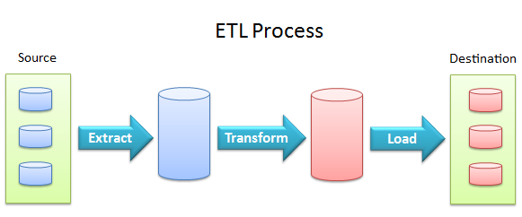
ETL PROCESS
Data comes from various sources, such as spreadsheets, mail lists, databases, etc.
The required data is extracted, transformed to suit information needs and finally loaded at a central location.
This is done by ETL (Extract Transform Load) process.

Slide 6
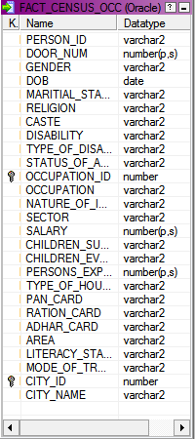
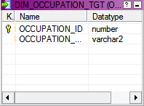
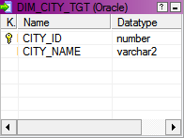
SCHEMA

Slide 7
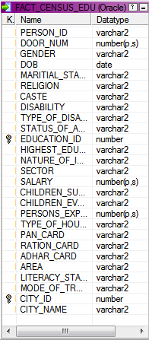
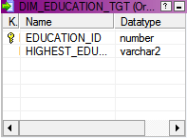
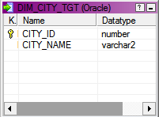
SCHEMA

Slide 8
TECHNOLOGY
HARDWARE:
Intel Core™ i5 CPU
Microsoft Windows 7 Enterprise
Memory and OS: 8GB RAM and 64 Bit Operating System
SOFTWARE:
Oracle 11g (Database)
Informatica PowerCenter 9.6.0 (ETL Tool):-
BusinessObjects XI Release 4

Slide 9




FLOWCHART
FLAT FILE
STAGING TABLE
DIMENSION TABLES
FACT TABLES

Slide 10
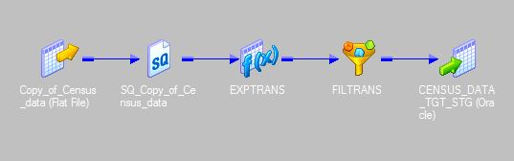
MAPPING
STAGING TABLE
Expressions
Filter Conditions

Slide 11
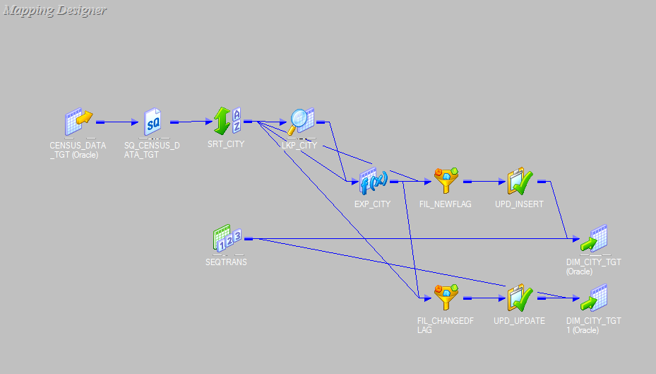
MAPPING OF DIMENSIONAL TABLE
MAPPING FOR CITY : SCD TYPE-1

Slide 12
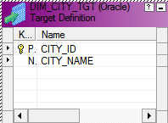
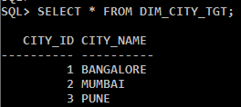

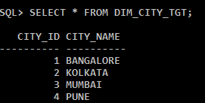
OUTPUT FOR CITY
DIMENSION TABLE : CITY
OUTPUT FOR CITY TABLE
INSERTING VALUES IN STAGING TABLE
OUTPUT AFTER INSERTING VALUES

Slide 13
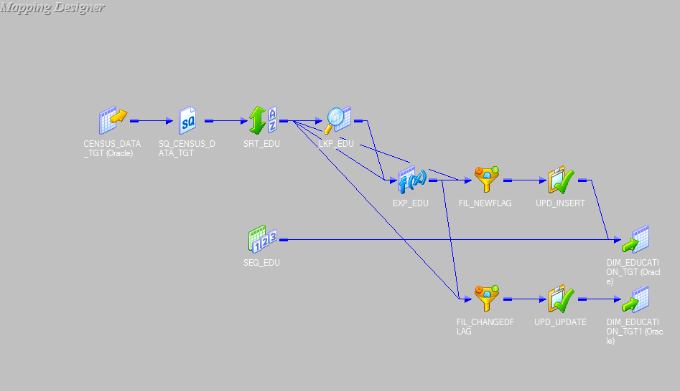
MAPPING FOR EDUCATION :
SCD TYPE-1

Slide 14
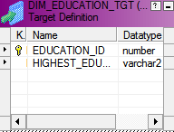
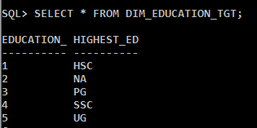
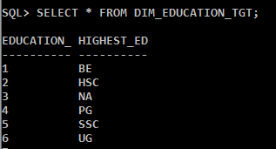
OUTPUT FOR EDUCATION
DIMENSION TABLE : EDUCATION
OUTPUT FOR EDUCATION TABLE
INSERTING VALUES IN STAGING TABLE
OUTPUT AFTER INSERTING VALUES

Slide 15
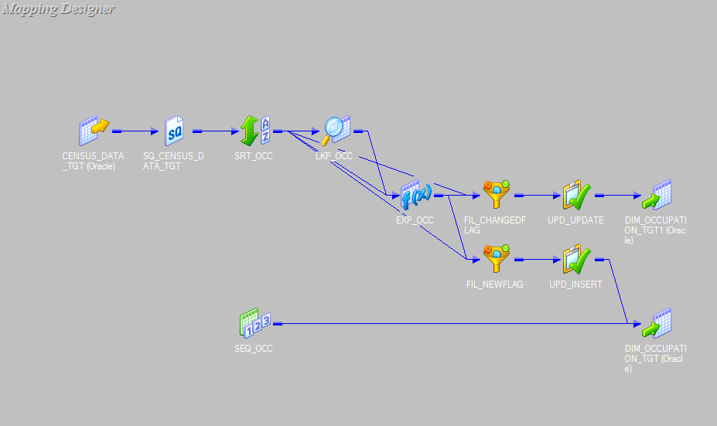
MAPPING FOR OCCUPATION :
SCD TYPE-1

Slide 16
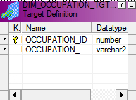
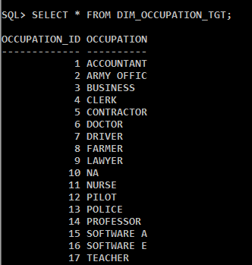
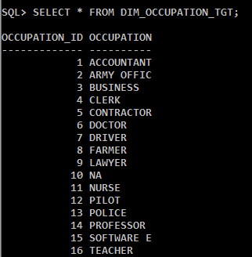
OUTPUT FOR OCCUPATION
DIMENSION TABLE :OCCUPATION
INSERTING VALUES IN STAGING TABLE
OUTPUT FOR OCCUPATION TABLE OUTPUT AFTER INSERTING VALUES

Slide 17
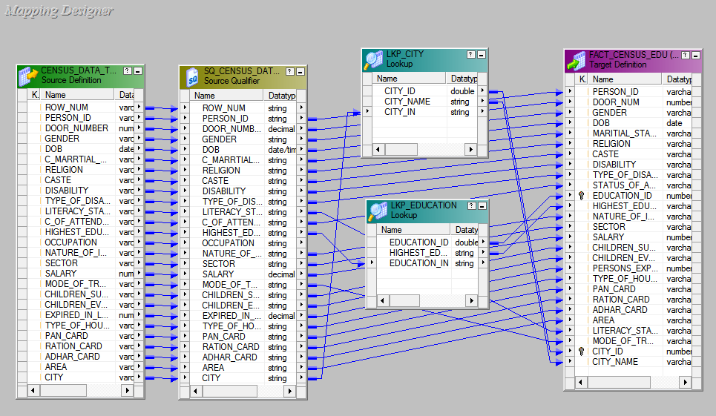
MAPPING FOR FACT TABLE : EDUCATION

Slide 18
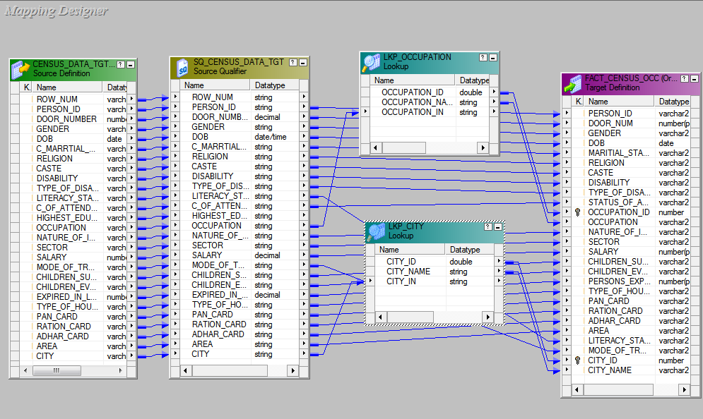
MAPPING FOR FACT TABLE : OCCUPATION

Slide 19
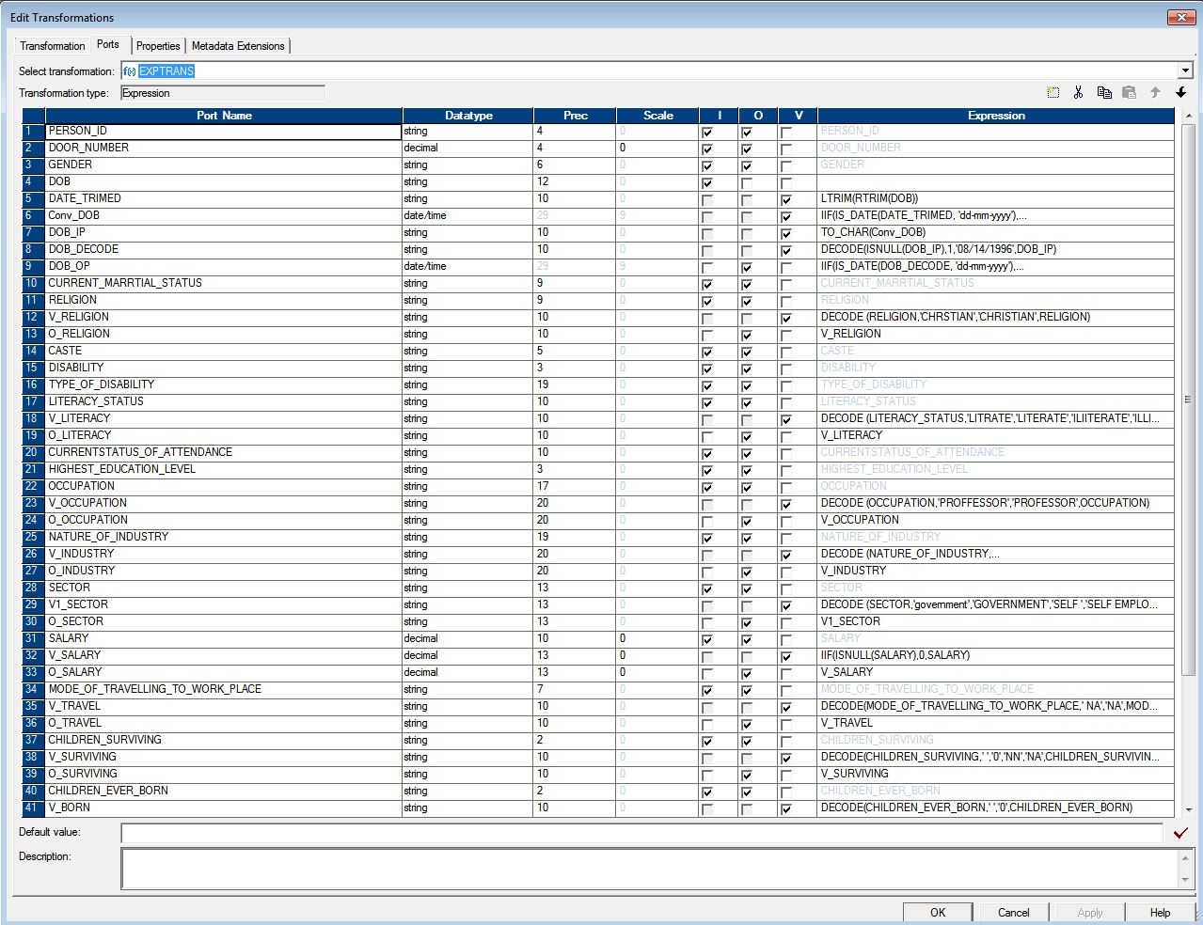

Slide 20
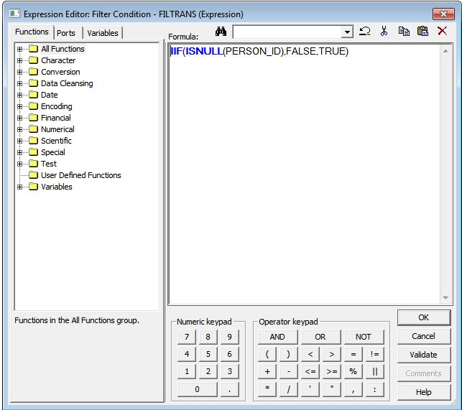

Slide 21
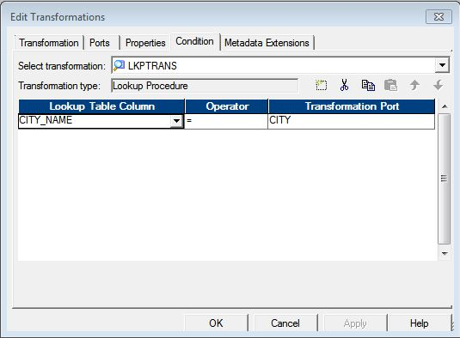

Slide 22
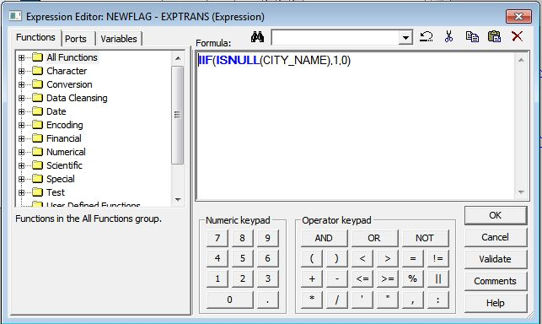

Slide 23
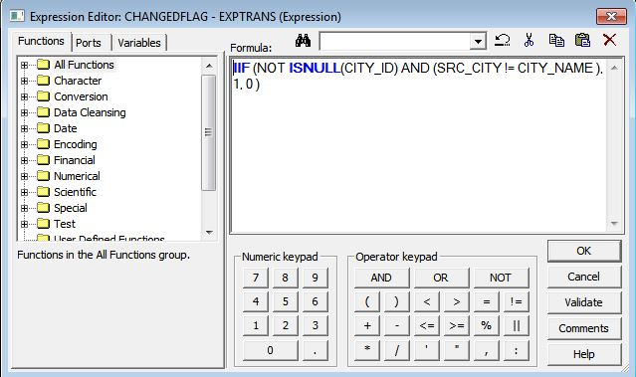

Slide 24
